Slide 1
.NET Framework
.NET is a framework to develop software applications. It is designed and developed by Microsoft and the first beta version released in 2000.
It is used to develop Form-based applications, Web-based applications, and Web services.
It provides a broad range of functionalities and support.

Slide 2
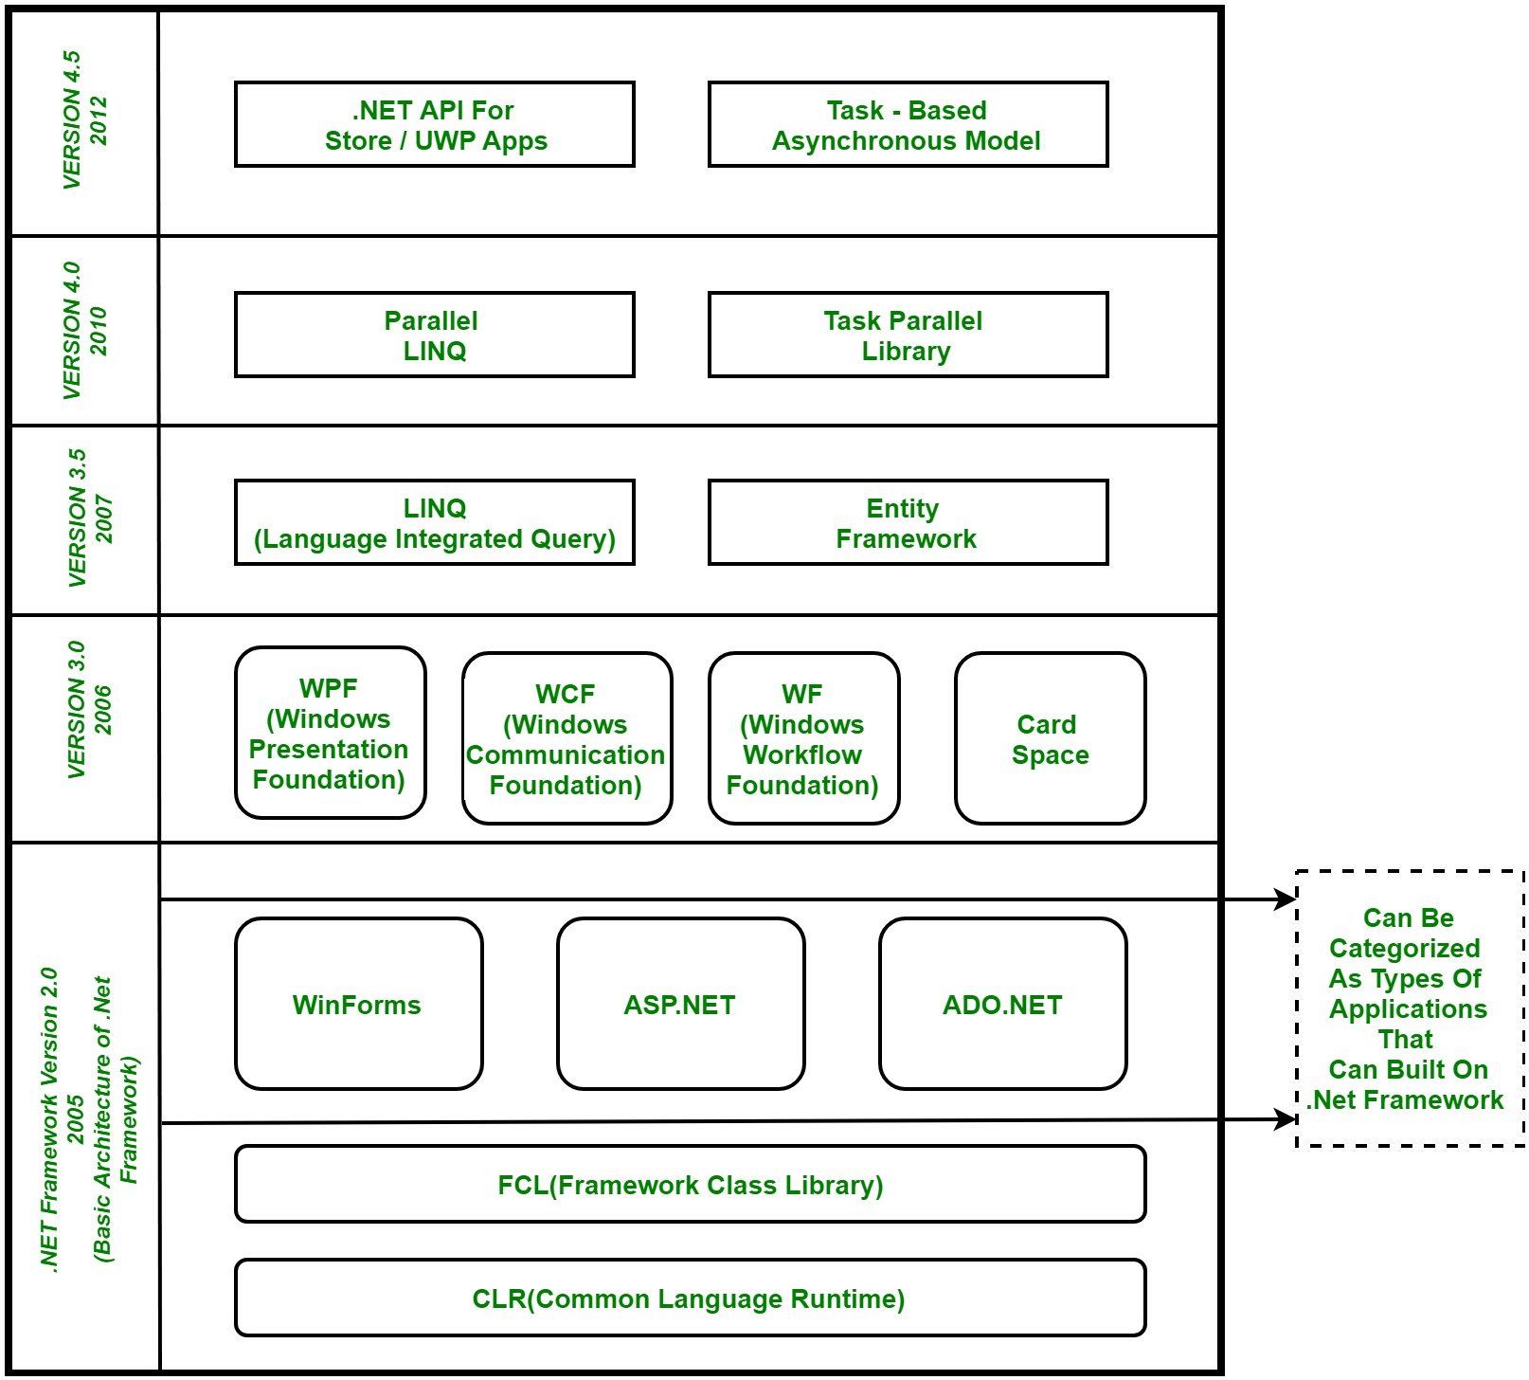
Components of .NET Framework:
Common Language Runtime (CLR)
Framework Class Library (FCL),
Core Languages (WinForms, ASP.NET, and ADO.NET), and
Other Modules (WCF, WPF, WF, Card Space, LINQ, Entity Framework, Parallel LINQ, Task Parallel Library, etc.)
Basic Architecture and Component Stack of .NET Framework

Slide 3
CLR (Common Language Runtime)
It is a program execution engine that loads and executes the program.
It converts the program into native code. It acts as an interface between the framework and operating system.
It does exception handling, memory management, and garbage collection. Moreover, it provides security, type-safety, interoperability, and portability.
Some of the CLR COMPONENTS are:
Basic class library thread support COM Marshaler Type Checker Exception Manager Security Engine Debug Engine Code manager Garabage collector

Slide 4
FCL (Framework Class Library)
It is a standard library that is a collection of thousands of classes and used to build an application. The BCL (Base Class Library) is the core of the FCL and provides basic functionalities.
It is the collection of reusable, object-oriented class libraries and methods, etc that can be integrated with CLR. Also called the Assemblies. It is just like the header files in C/C++ and packages in java. Installing the .NET framework basically is the installation of CLR and FCL into the system

Slide 5
Core Languages (WinForms, ASP.NET, and ADO.NET):
WinForms: Windows Forms is a smart client technology for the .NET Framework, a set of managed libraries that simplify common application tasks such as reading and writing to the file system.
ASP.NET: ASP.NET is a web framework designed and developed by Microsoft. It is used to develop websites, web applications, and web services. It provides a fantastic integration of HTML, CSS, and JavaScript. It was first released in January 2002.
ADO.NET:ADO.NET is a module of .Net Framework, which is used to establish a connection between application and data sources. Data sources can be such as SQL Server and XML. ADO .NET consists of classes that can be used to connect, retrieve, insert, and delete data.
WPF (Windows Presentation Foundation):Windows Presentation Foundation (WPF) is a graphical subsystem by Microsoft for rendering user interfaces in Windows-based applications. WPF, previously known as "Avalon", was initially released as part of .NET Framework 3.0 in 2006. WPF uses DirectX.
WCF (Windows Communication Foundation):It is a framework for building service-oriented applications. Using WCF, you can send data as asynchronous messages from one service endpoint to another.
WF (Workflow Foundation):Windows Workflow Foundation (WF) is a Microsoft technology that provides an API, an in-process workflow engine, and a rehost able designer to implement long-running processes as workflows within .NET applications.
LINQ (Language Integrated Query):It is a query language, introduced in .NET 3.5 framework. It is used to make the query for data sources with C# or Visual Basics programming languages.
Entity Framework: It is an ORM based opensource framework which is used to work with a database using .NET objects. It eliminates a lot of developer's effort to handle the database.
Parallel LINQ:Parallel LINQ or PLINQ is a parallel implementation of LINQ to objects. It combines the simplicity and readability of LINQ .

Slide 6
Other Forms:
WPF (Windows Presentation Foundation):Windows Presentation Foundation (WPF) is a graphical subsystem by Microsoft for rendering user interfaces in Windows-based applications. WPF, previously known as "Avalon", was initially released as part of .NET Framework 3.0 in 2006. WPF uses DirectX
. WCF (Windows Communication Foundation):It is a framework for building service-oriented applications. Using WCF, you can send data as asynchronous messages from one service endpoint to another.
WF (Workflow Foundation):Windows Workflow Foundation (WF) is a Microsoft technology that provides an API, an in-process workflow engine, and a rehost able designer to implement long-running processes as workflows within .NET applications.
LINQ (Language Integrated Query):It is a query language, introduced in .NET 3.5 framework. It is used to make the query for data sources with C# or Visual Basics programming languages.
Entity Framework: It is an ORM based opensource framework which is used to work with a database using .NET objects. It eliminates a lot of developer's effort to handle the database.
Parallel LINQ: Parallel LINQ or PLINQ is a parallel implementation of LINQ to objects. It combines the simplicity and readability of LINQ .

Slide 7
.NET Common Language Runtime (CLR):
.NET CLR is a run-time environment that manages and executes the code written in any .NET programming language.
It converts code into native code which further can be executed by the CPU.
.NET CLR Functions:
It converts the program into native code.
Handles Exceptions
Provides type-safety
Memory management
Provides security
Improved performance
Language independent
Platform independent
Garbage collection

Slide 8
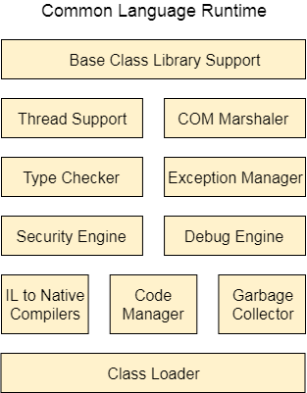
.NET CLR Versions
The CLR updates itself time to time to provide better performance.
.NET CLR Structure:
Base Class Library Support
It is a class library that provides support of classes to the .NET application.
Thread Support
It manages the parallel execution of the multi-threaded application.
COM Marshaler
It provides communication between the COM objects and the application.
Type Checker
It checks types used in the application and verifies that they match to the standards provided by the CLR.
Code Manager
It manages code at execution run-time.
Garbage Collector
It releases the unused memory and allocates it to a new application.
Exception Handler
It handles the exception at runtime to avoid application failure.
ClassLoader
It is used to load all classes at run time.

Slide 9
.NET Framework Class Library
.NET Framework Class Library is the collection of classes, namespaces, interfaces and value types that are used for .NET applications.
It contains thousands of classes that supports the following functions.
Base and user-defined data types
Support for exceptions handling
input/output and stream operations
Communications with the underlying system
Access to data
Ability to create Windows-based GUI applications
Ability to create web-client and server applications
Support for creating web services

Slide 10
Categories in the Framework Class Library: The functionality of the Framework Class Library can be broadly divided into three categories i.e utility features written in .NET, wrappers around the OS functionality and frameworks. These categories are not rigidly defined and there are many classes that may fit into more than one category.
System:
It includes all common datatypes, string values, arrays and methods for data conversion.
System.Data, System.Data.Common, System.Data.OleDb,System.Data.SqlClient, System.Data.SqlTypes:
These are used to access a database, perform commands on a database and retrieve database.
System.Diagnostics:
It is used to debug and trace the execution of an application.
System.Security, System.Security.Permissions, System.Security.Policy, System.WebSecurity, System.Security.Cryptography:
These are used for authentication, authorization, and encryption purpose.
NET Framework Base Class Library:
.NET Base Class Library is the sub part of the Framework that provides library support to Common Language Runtime to work properly. It includes the System namespace and core types of the .NET framework.

Slide 11
C#
C# is a programming language of .Net Framework.

Slide 12
By the help of C# programming language, we can develop different types of secured and robust applications:
Window applications
Web applications
Distributed applications
Web service applications
Database applications etc.
C# is approved as a standard by ECMA and ISO. C# is designed for CLI (Common Language Infrastructure). CLI is a specification that describes executable code and runtime environment.
C# programming language is influenced by C++, Java, Eiffel, Modula-3, Pascal etc. languages.

